Slide 1

Intelligent Feedback Pipeline
Michael Zhang
Sept 12, 2019

Slide 2

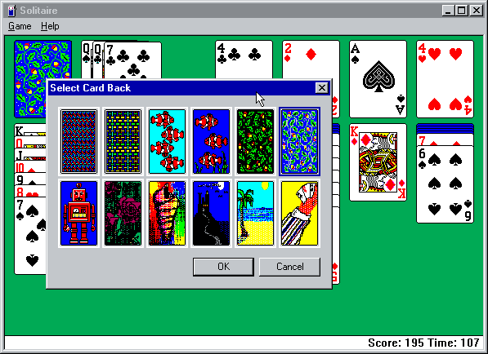
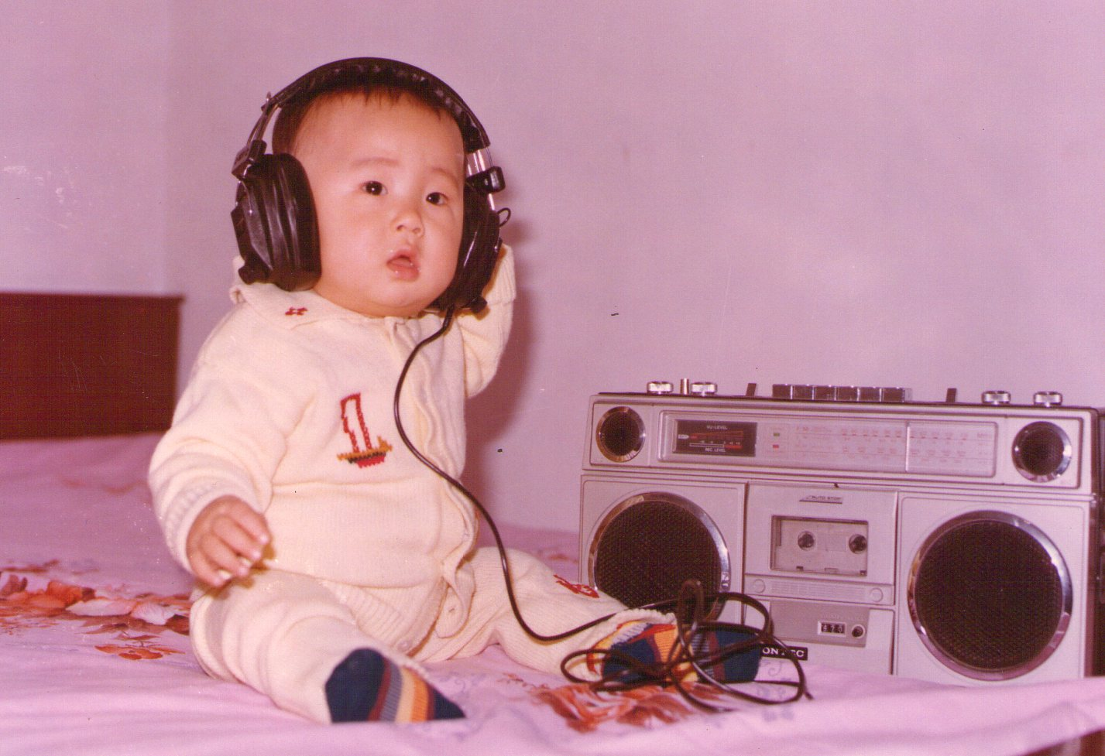

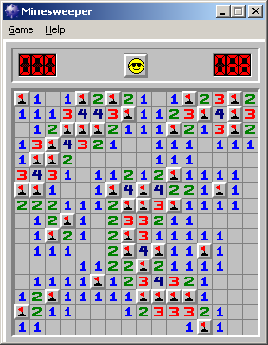
Get It Personal
Notes:
I once doubt it is a type of parental control built by Microsoft to limit my game time.

Slide 3





How do Microsoft customers get heard and understood?
Unique Feedback Platform

Slide 4

FeedHack Feedback Classification by Language Model Embeddings Photo by Allie Smith on Unsplash

Slide 5
Motivation
Automate Issue-based classification of users’ feedback
Bug and fix triage and prioritization (RDX)
Labor cost saving by domain expert reviewing process (Customer Support)
Bursty Event Detection (Monitoring)
Leverage unsupervised learning to address the challenge of large amount of unlabeled training data
Compare the performance among pre-trained language models applied domain-specific learning

Slide 6
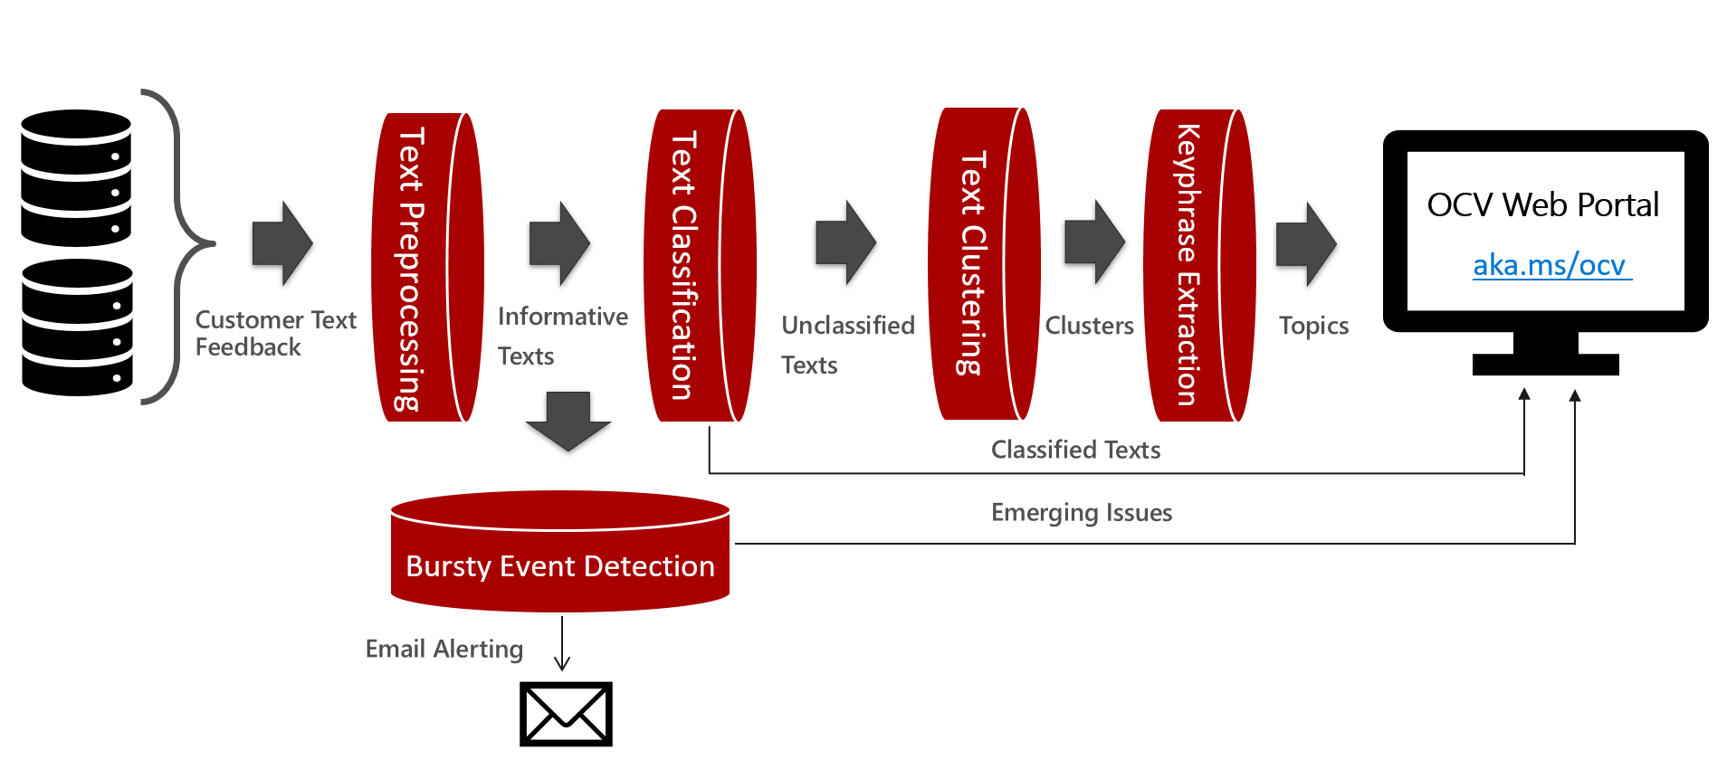
Current Pipeline

Slide 7


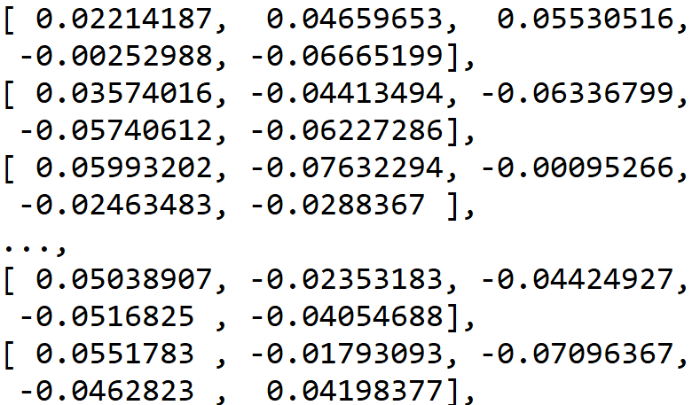
Better Solution - Featurization
Customer Feedback
Text Preprocessing
Model 1: Featurizer
Embedding Rep
Model 2: Classifiers
Performance
Reliability
Usability
….
Every feedback is featurized as a vector in the high-dimension space
Word-based: (i.e. Word2Vec, GloVe)
Sentence-based: (i.e. Concat Word2Vec)
Document-based (i.e. BERT, ELmo)
Embedding representations are fed to downstream classifiers
Logistic regression
Support Vector Machine
Neural Network-based Softmax classifier

Slide 8
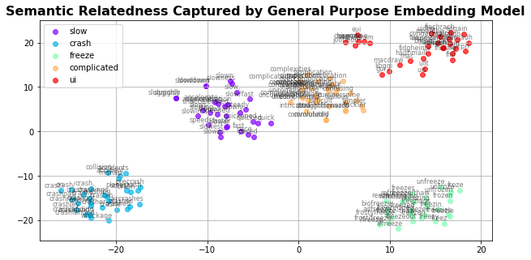
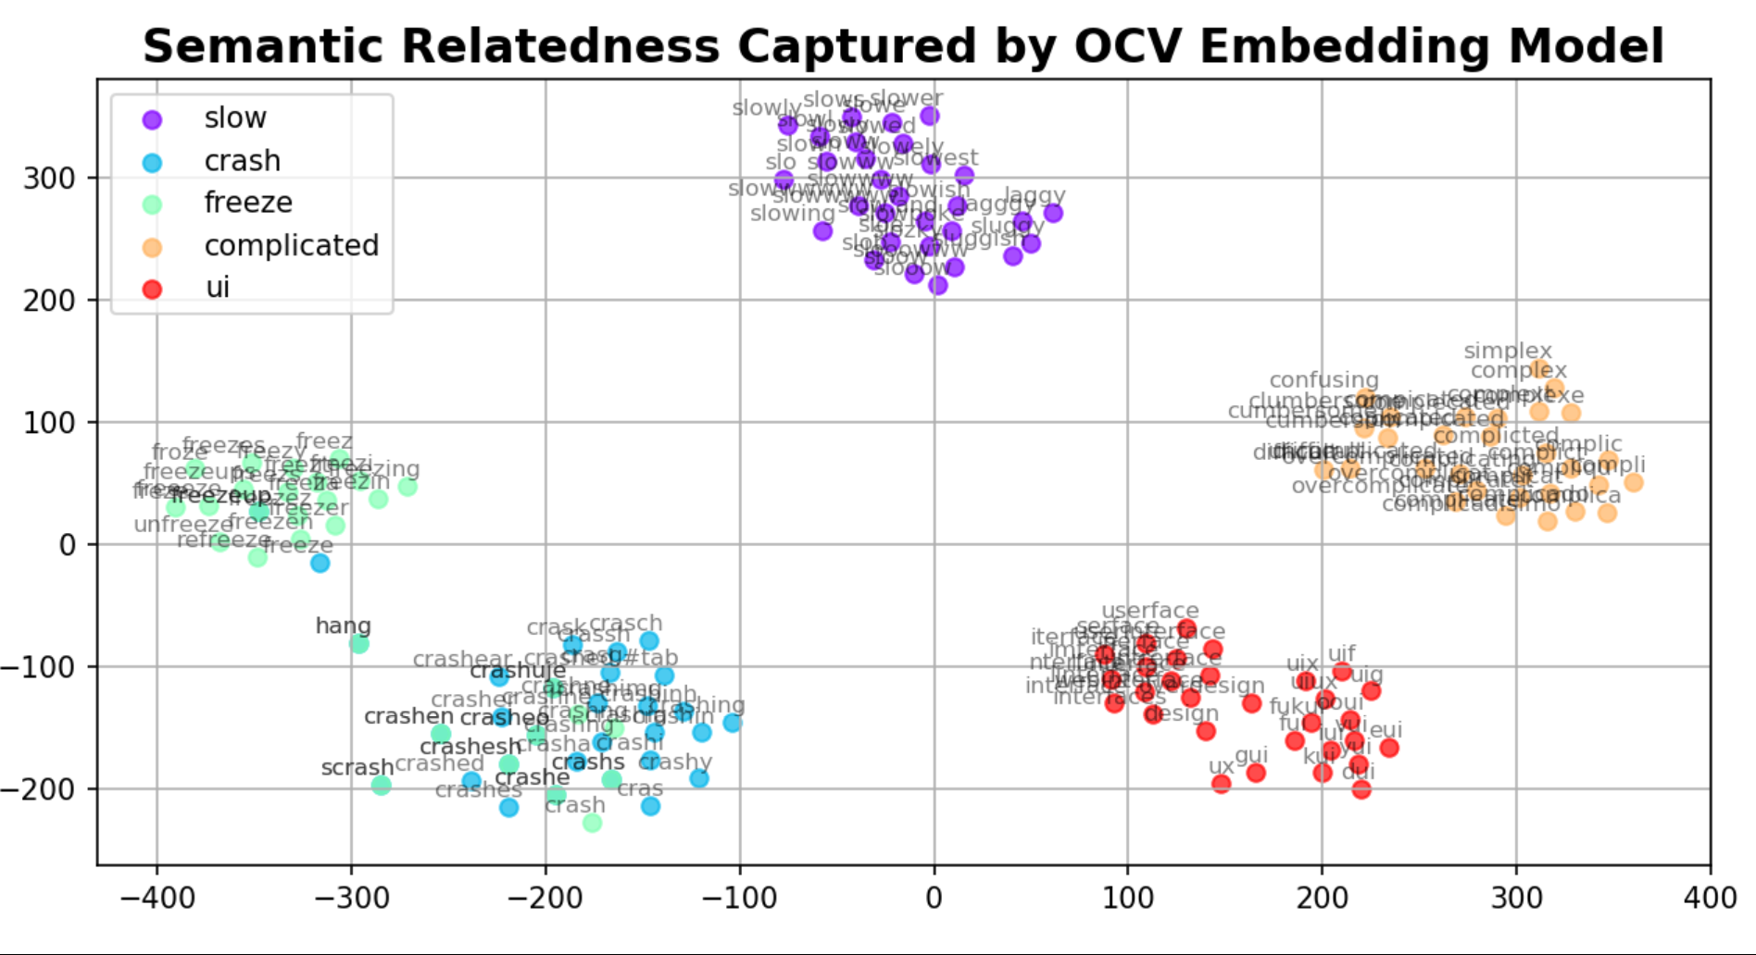
Semantic Relatedness Comparison
A
General-Purpose
B
Domain-Specific
Crash and Freeze are far apart in a general-purpose embedding space
Crash and Freeze are closer in a software domain embedding space
Notes:
(t-SNE) t-Distributed Stochastic Neighbor Embedding is a non-linear dimensionality reduction algorithm used for exploring high-dimensional data. It maps multi-dimensional data to two or more dimensions suitable for human observation.

Slide 9
Transfer Learning from Public Pre-trained Models
 | Pre-trained Models | Model Type | Training Data | Dimension
1 | BERT (2018) Bidirectional Encoder Representations from Transformers Model: BERT-Base, Uncased 12-layer, 768-hidden, 12-heads, 110M parameters https://github.com/hanxiao/bert-as-service | Language Model | Wikipedia + BookCorpus 3.3B tokens | 768
2 | ELMo (2018) Embeddings from Language Models https://tfhub.dev/google/elmo/2 | Language Model | 1 Billion Word Benchmark Free texts on the web | 1024
3 | fastText (2017) https://fasttext.cc/docs/en/english-vectors.html | Word Embedding | Wikipedia 2017 + UMBC webbase corpus + statmt.org news dataset 16B tokens | 300
4 | XLNet (2019) Autoregressive, Permutation Language Modeling Two Streams Self-Attention Large: 24-layer, 1024-hidden, 16-heads Base: 12-layer, 768-hidden, 12-heads https://github.com/zihangdai/xlnet | Language Model | BooksCorpus + English Wikipedia + Giga5 + ClueWeb 2012-B + Common Crawl | Large: 1024 Base: 768
Table 1. Public General-Purpose Pre-trained Models Experimented

Slide 10
Architecture
Azure Blob Storage Container
Model objects
Training Data (100K)
Test Data
(20944)
BERT
ELMo
Training Scripts
fastText
Training Scripts
Training Scripts
XLnet
Downstream task
Classification
Clustering
etc…
Get_embeddings script
Embeddings

Slide 11
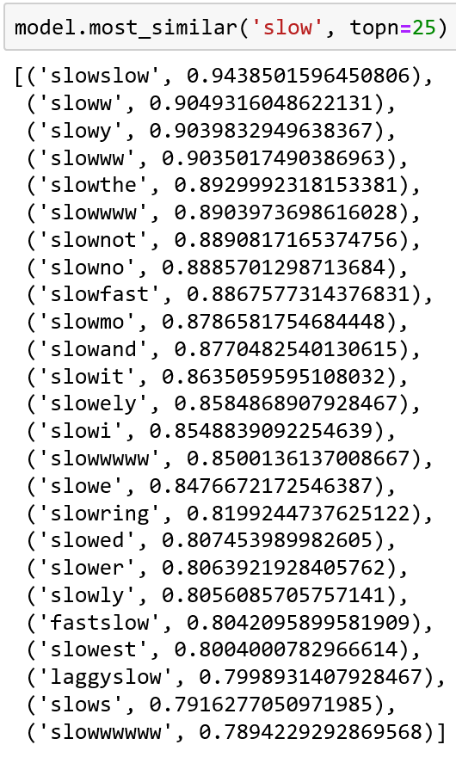
Related Word Embeddings
Domain-specific training
Embedded by fastText
Learn exclamation / misspellings / slangs from the corpora

Slide 12
Classification
Used 9 downstream logistic regression classifiers as transfer tasks
Used Precision, Recall, AUC and F1 score to evaluate performance
fastText slightly outperforms Elmo (Training speed and Accuracy)

Slide 13
Lessons learnt
Transfer learning can boost accuracy for target domain since embeddings learnt from domain-specific unlabeled dataset are relevant.
Generally, we have found training to be relatively insensitive to the hyperparameters. (i.e. Batch size, Learning rate, Windows size, Epoch, etc.)
Averaging out from words to document (i.e. Elmo, fastText) embeddings does not have major impact on accuracy.
Dictionary-based model (i.e. Word2Vec, fastText) is faster and resource-efficient than attention-based model (i.e. BERT, Elmo), which might not be practical to use in production environment.
Project repo : https://msblox-03.visualstudio.com/feedhack

Slide 14
Can we do better?
How about
labeled feedback?
But, who will label them?
Wait, is there a thing called
crowdsourcing?

Slide 15

TransplanRL Crowdsourcing Planner by Reinforcement Learning Photo by Nicholas Green on Unsplash

Slide 16

Motivation
To verify and improve the quality of machine translation for core products
To simulate crowdsourcing users’ behavior pattern based on the experimental data
To optimize translation work order process constrained by certain SLA and budget
To provide a general reinforcement learning framework for all crowdsourcing planning

Slide 17
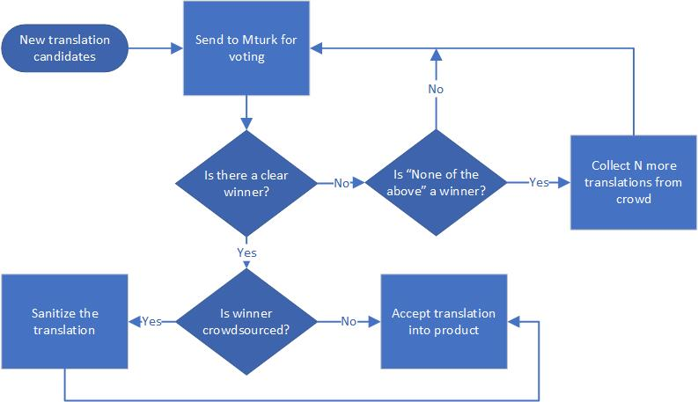
Workflow

Slide 18

Problem Definition
Possible paths:
Voting -> Collecting N candidates -> Voting -> Finish
Voting -> Eliminate lowest candidate -> Voting -> Finish
Question:
What’s the sequence of actions that maximize the amount and quality of translation from Mechanical Turk under certain SLA and budget?
Key Components:
Simulator of gig user behavior -> Environment
Actuator to act and accept reward-> Agent
Quantity and Quality of translation work order -> Reward
Progress of total work orders -> State

Slide 19
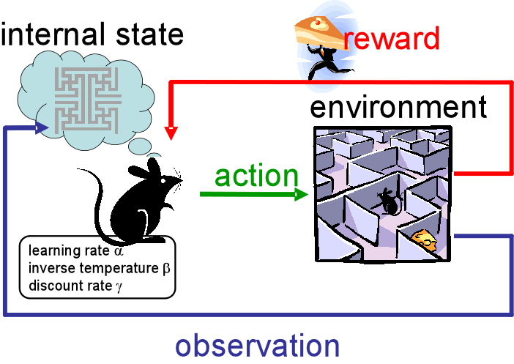
Reinforcement Learning in nutshell

Slide 20
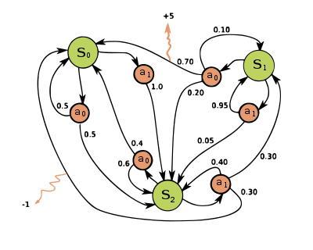

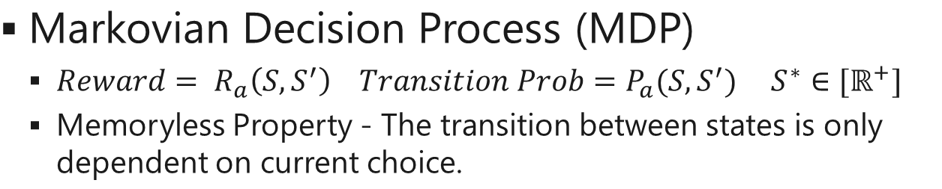
Hypotheses
Markovian Decision Process (MDP)
${{Reward= R}_{a}\left(S, S^{′}\right) Transition Prob=P_{a}(S, S^{′}) S}^{∗}∈[ℝ^{+}]$
Memoryless Property - The transition between states is only dependent on current choice.
Constrained Contextual Multi-armed Bandit (CCB)
Allocate fixed limited resource to competing choices and expect maximum return
When a cost is associated with each action, optimization became even harder.
Instant-runoff voting vs Plurality voting
Presumably, preferential voting is more likely to form quorum than plurality voting.

Slide 21

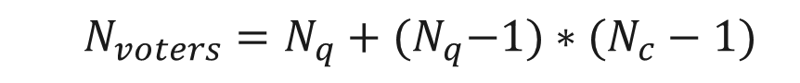
Problem Setup
Mechanical Turk Job
100 translation source strings
3 hours SLA
7 dollars Budget
3 machine translation candidates
5 votes quorum
13 voters
Workflow
Initial voting round, possibly finish the job.
If not, follow-up voting will start.
Question
What is the optimal action at this stage?
$$N_{voters}=N_{q}+{(N}_{q}−1)∗(N_{c}−1)$$

Slide 22
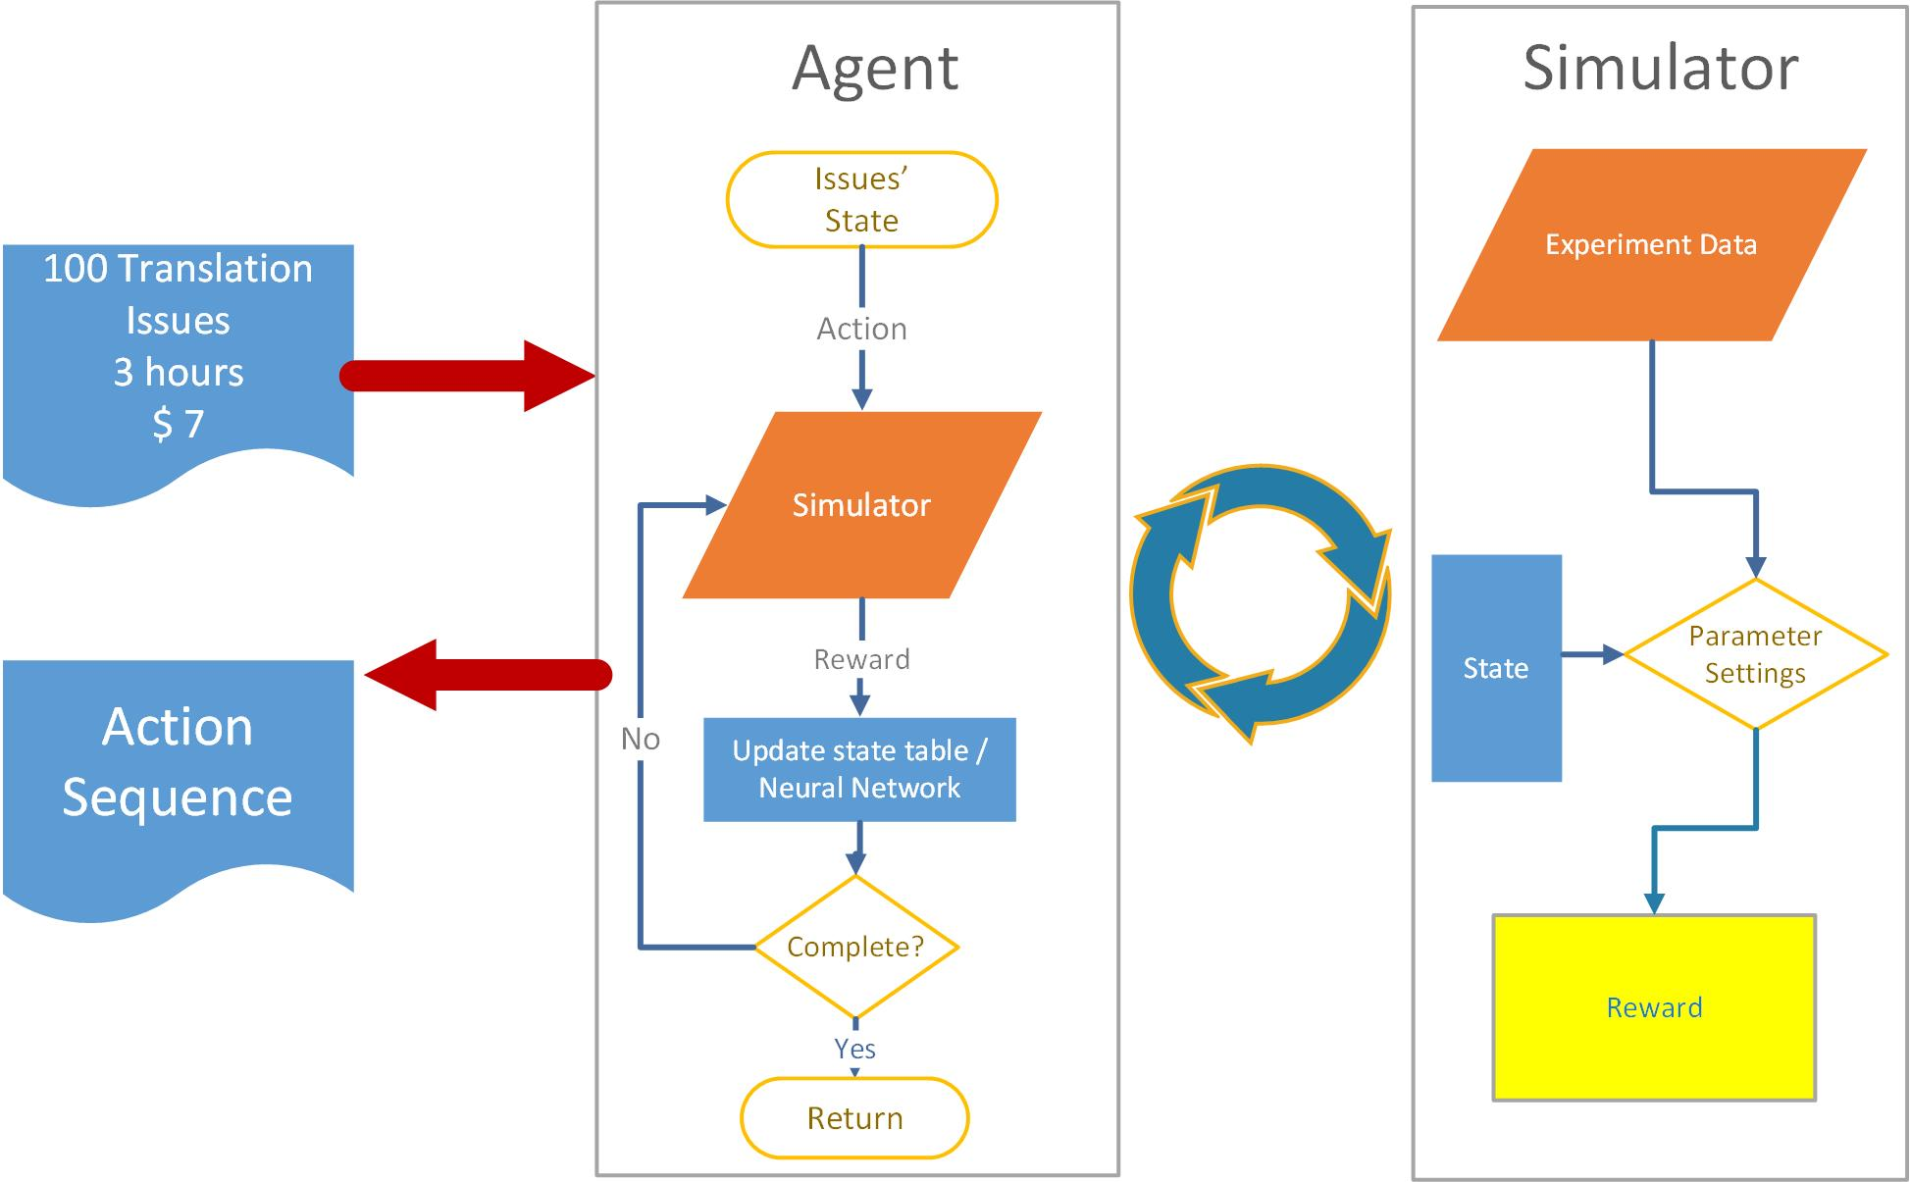
Architecture

Slide 23
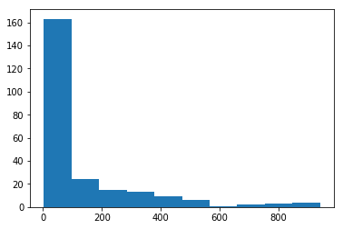
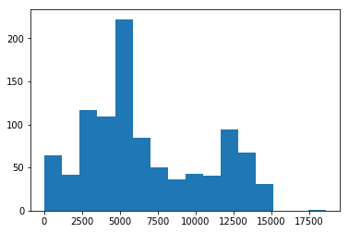
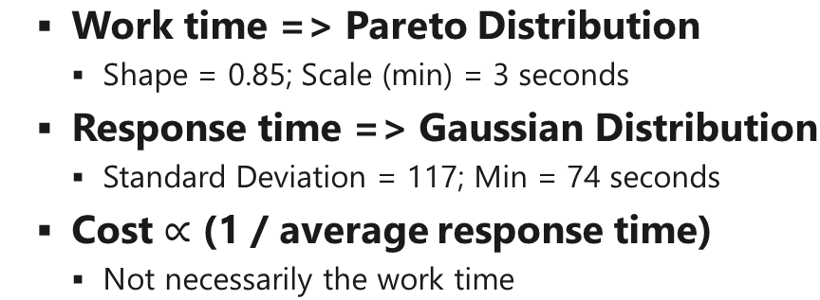
User Behavioral Pattern
Work time => Pareto Distribution
Shape = 0.85; Scale (min) = 3 seconds
Response time => Gaussian Distribution
Standard Deviation = 117; Min = 74 seconds
Cost $∝$ (1 / average response time)
Not necessarily the work time
Response Time | Work Time
Job Posted
Job Picked
Job Finished
Table 2. Distribution of Work Time
Table 3. Distribution of Response Time
Notes:
Simulator generates new samples by distributions and parameters

Slide 24
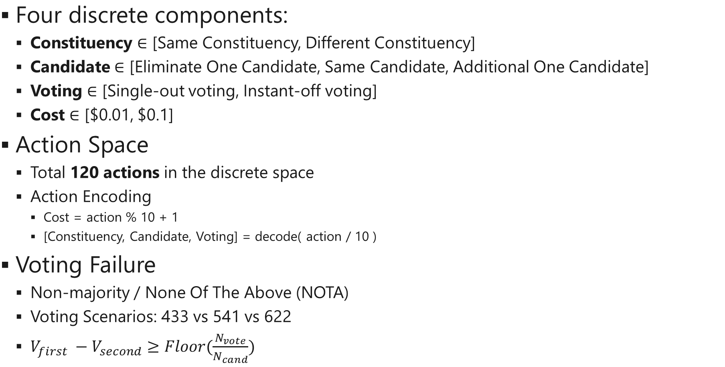
Action
Four discrete components:
Constituency $∈$ [Same Constituency, Different Constituency]
Candidate $∈$ [Eliminate One Candidate, Same Candidate, Additional One Candidate]
Voting $∈$ [Single-out voting, Instant-off voting]
Cost $∈$ [$0.01, $0.1]
Action Space
Total 120 actions in the discrete space
Action Encoding
Cost = action % 10 + 1
[Constituency, Candidate, Voting] = decode( action / 10 )
Voting Failure
Non-majority / None Of The Above (NOTA)
Voting Scenarios: 433 vs 541 vs 622
$V_{first} −V_{second}≥Floor(\frac{N_{vote}}{N_{cand}})$
 | Constituency | Candidate | Voting
0 | 0 | 0 | 0
1 | 0 | 0 | 1
2 | 0 | 1 | 0
3 | 0 | 1 | 1
4 | 0 | 2 | 0
5 | 0 | 2 | 1
6 | 1 | 0 | 0
7 | 1 | 0 | 1
8 | 1 | 1 | 0
9 | 1 | 1 | 1
10 | 1 | 2 | 0
11 | 1 | 2 | 1

Slide 25
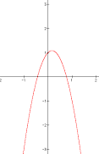
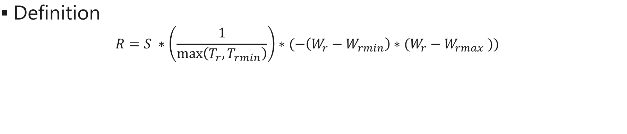
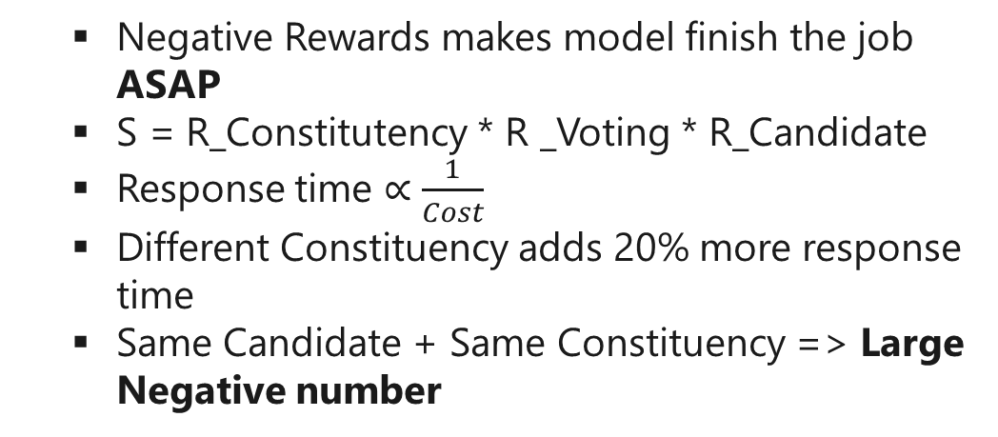
Reward
Definition
$$R=S ∗\left(\frac{1}{\max\left(T_{r}, T_{rmin}\right)}\right)∗(−\left(W_{r}−W_{rmin}\right)∗(W_{r}−W_{rmax} ))$$
Success
Rate
Inverse Response Time Factor
Quadratic Work Time
Factor
Negative Rewards makes model finish the job ASAP
S = R_Constitutency * R _Voting * R_Candidate
Response time $∝$ $\frac{1}{Cost}$
Different Constituency adds 20% more response time
Same Candidate + Same Constituency => Large Negative number
Constituency | Same | Different
Reward | 0.8 | 1.0
Voting | Single-out Voting | Instant-off Voting
Reward | 0.8 | 1.0
Candidate | Eliminate One | Same | Additional
Reward | 1 | 0.8 | 1.2

Slide 26

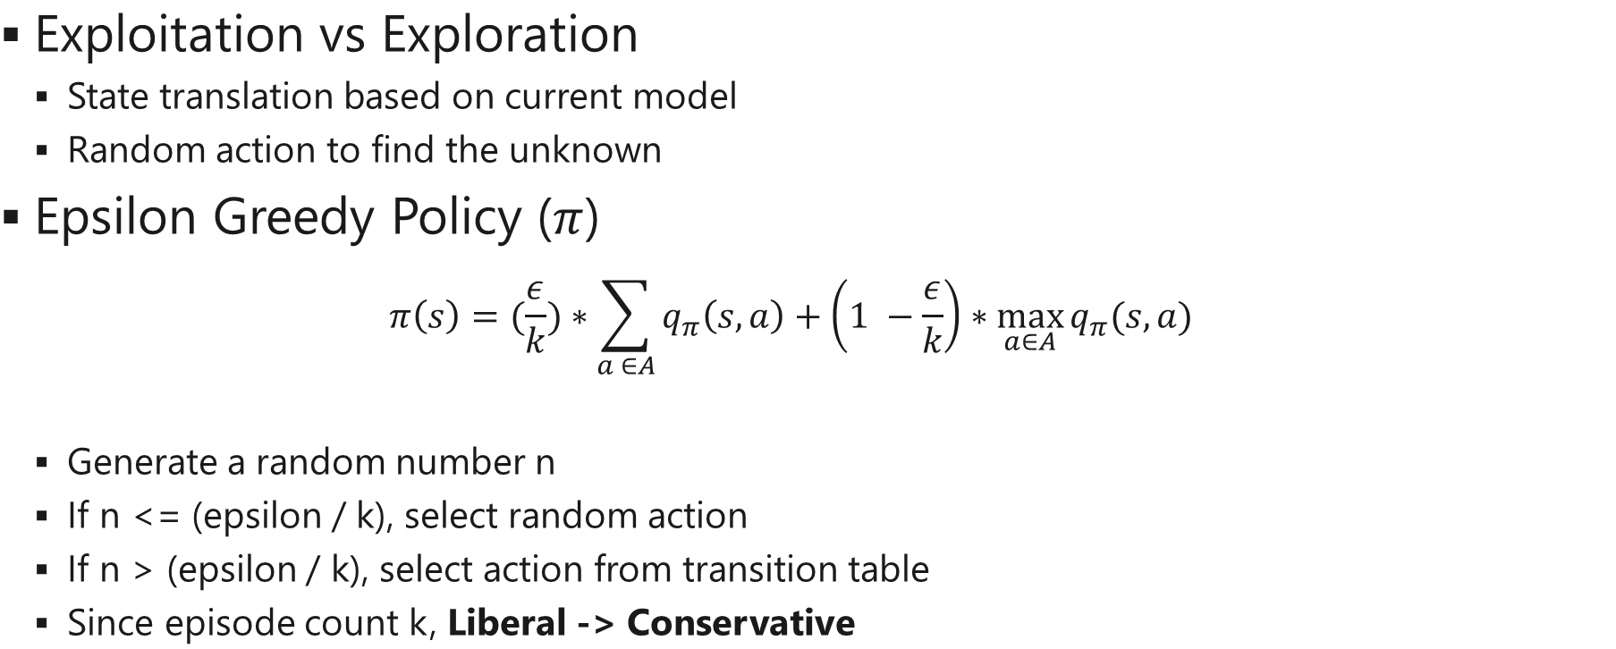
Policy
Exploitation vs Exploration
State translation based on current model
Random action to find the unknown
Epsilon Greedy Policy ($π$)
$$π\left(s\right)=(\frac{ε}{k})∗\sum_{a ∈A}{q_{π}\left(s, a\right)}+\left(1 −\frac{ε}{k}\right)∗\max_{a∈A}{q_{π}(s,a)}$$
Generate a random number n
If n <= (epsilon / k), select random action
If n > (epsilon / k), select action from transition table
Since episode count k, Liberal -> Conservative

Slide 27
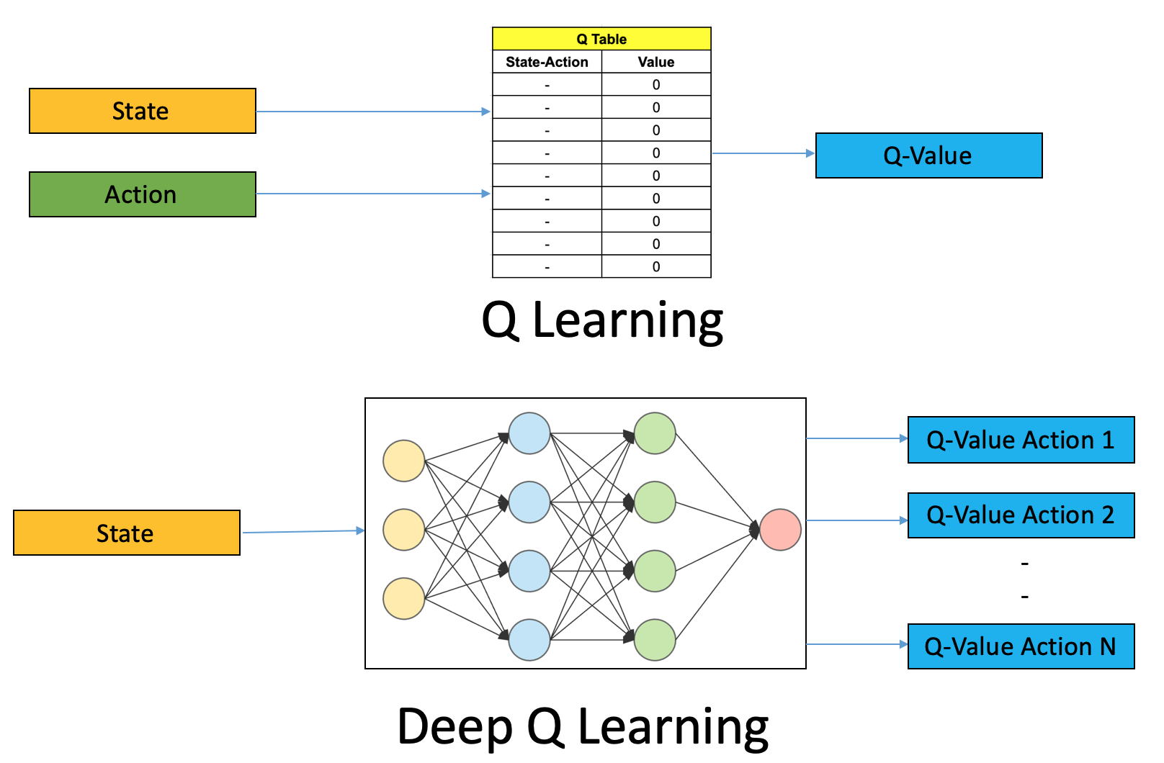
Algorithm

Slide 28
Result
TransplanRL successfully captures the preset rewarding mechanism
Avoids same constituency and same candidate
Finish the work order sooner than later
Two-stage Convergence Procedure
Move from low to high reward actions (33 -> 74 -> 119)
Balance out at intermediate cost (119 -> 113 -> 116)
Optimal Action(s)
A sequence of 116 action given the problem settings
Different Constituency, Extra Candidate, Preferential Voting, $0.07
SLA-first vs Budget-first
Notes:
Epoch = 100, epoch_length = 100, Test_per_epoch = 20
33 (Same Constituency, Same Candidate, Preferential Voting, $ 0.04)
74 (Different Constituency, Eliminate one Candidate, Preferential Voting, $ 0.05)
119 (Different Constituency, Additional Candidate, Preferential Voting, $ 0.1)

Slide 29
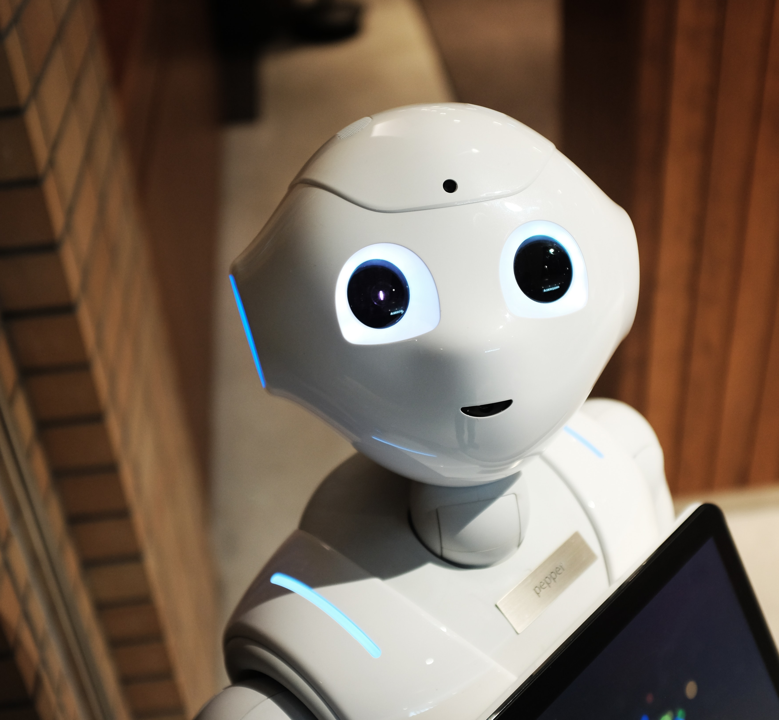
Future Work
Extend to other crowdsourcing planning
Provide APIs for environment creation
Take languages into account
Reward induction by experimental data
Enable action in continuous space
Project repo: https://dev.azure.com/msblox/TransplanRL

Slide 30
Additional Slides

Slide 31
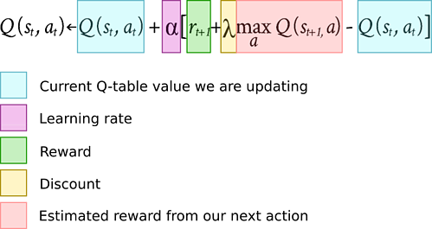
Q-Learning

